Slide 1
Dynamic Programming
Also known as Dynamic planning Often used to solve optimization problems

Slide 2
Dynamic Programming
Compared to divide-and-conquer DP acts similar, and designed according to the method of recursion algorithm.
Also compared to divide-and-conquer :The biggest difference is that sub-problems are not independent, but overlapping ones.
P(n)
P(m₁) P(m₂) …. P(m_{k})
S₁ S₂ …. S_{k}
S

Slide 3
What is Dynamic Programming?
Similar to the divide-and-conquer method, DP is an algorithmic design approach that uses the concept of recalling concepts.
The so-called recursive concept of solution as shown in the projection of the icon shows:
a parameter n of the concept P(n) (parameters may be a number or several numbers) to find ways to decompose it into k ≥ 1 P(m₁), P(m₂), …. , P(m_{k}) according to the concept of recursion. Suppose the answer to these sub-questions is S₁, S₂, …. , S_{k}.

Slide 4
Dynamic Programming ? continued
At this point we have a way to synthesize S₁, S₂, …. , S_{k} into the answer S of P(n), then the idea that the design was passed back is successful.
However, here the so-called "sub-problems are not independent but overlapping" means that when one of the two sub-problems P(m_{i}) and P(m_{j}) is decomposed by the way of recursion, a certain sub-problem of P and P(m_{j}) a sub-problem is exactly the same.
Therefore, a major consideration of DP design is to avoid double counting these same problems.

Slide 5
Dynamic Programming is Applicable to Optimization
In optimization, DP is applicable when subproblems are not independent, that is, when subproblems share subproblems. So, problems are such that mere divide and conquer algorithm will be doing similar computation again and again in multiple similar subproblems.
DP maintains a table like structure to store the solution results of subproblems upon first coming across. For later incidents those stored results are reused rather than solving the subproblem again and again.

Slide 6
Dynamic Programming: Steps to be followed
Characterize the structure of an optimal solution.
Derive a recursive formula for computing the values of optimal solutions.
Compute the value of an optimal solution in a bottom-up fashion [solve subproblem first then up] (top-down is also applicable).
Construct an optimal solution in a top-down fashion from computed information.
In step 4 an optimal solution is synthesized from stored aditional information along solutions of subproblems. This step is omitted if only optimal result is required.

Slide 7
Iron cutting problem (Rod cutting problem)
Give a bar of length N (integer), let i be any positive integer, assuming that p[i] represents the price at which the bar of length i can be sold. How to cut the bar so that it is always sold The highest price?
Example：
Length i | 1 | 2 | 3 | 4 | 5 | 6 | 7 | 8 | 9 | 10
Price p[i] | 1 | 5 | 8 | 9 | 10 | 17 | 17 | 20 | 24 | 30
N=7,
7=3+4 can be sold for 17
7=1+6=2+2+3 can be sold 18.

Slide 8
To multiply a matrix of n strings together, the order of the calculation does not affect the result of the calculation as the matrix multiplication satisfies the law of combination.
For example, 4 matrixes that come together have 5 ways to calculate their product.
Although the final product is the same, the calculation of different calculation orders may be much worse when the size of each matrix is different.
The question is to find a calculation method with the least amount of computation.

Slide 9
Multiplication Matrix (Definition)
Give a series of matrices ⟨A₁, A₂, … , A_{n}⟩, where the size of the matrix A_{i} is p_{i−1}× p_{i}, and find a way to calculate the A₁A₂…A_{n} product so that the scalar multiplication used has the least amount of computation..
There are 5 ways to multiply 4 matrices in total:
Example： A₁ × A₂ × A₃ × A₄
p_{i} :13 5 89 3 34
(A₁(A₂(A₃A₄))), (A₁((A₂A₃)A₄)), ((A₁A₂ )( A₃A₄)),
((A₁(A₂ A₃))A₄), ((( A₁A₂)A₃)A₄).

Slide 10
Multiplication matrix (example)
(A₁(A₂(A₃A₄)))→ A₁×(A₂A₃A₄) → A₂×(A₃A₄) → A₃×A₄
cost = 13*5*34 + 5*89*34 + 89*3*34
= 2210 + 15130 + 9078
= 26418
A₁ × A₂ × A₃ × A₄
13 5 89 3 34
(A₁(A₂(A₃A₄))), costs = 26418
(A₁((A₂A₃)A₄)), costs = 4055
((A₁A₂ )( A₃A₄)), costs = 54201
((A₁(A₂ A₃))A₄), costs = 2856
((( A₁A₂)A₃)A₄), costs = 10582
For example, the four matrix multiplication of the above five kinds of calculation, their calculation, the best and worst, can be as much as 19 times.

Slide 11
Catalan Number
For any n, # ways to fully parenthesize the product of a chain of n+1 matrices
= # binary trees with n nodes.
= # permutations generated from 1 2 … n through a stack.
= # n pairs of fully matched parentheses.
= n-th Catalan Number = C(2n, n)/(n +1) = Ω(4^{n}/n^{3/2})
also = (2n)!/((n+1)! n!) = _{k=2}Π^{n} ((n+k)/k)

Slide 12
First of all, let's first understand how many calculations will be made for the product of a matrix of n strings.
In fact, this number is a very famous number in combinatorial mathematics called Catalan number, and this number is the same as that of many kinds of combined mathematical structures (as shown in the above slide).
Calculating the number of n+1 matrix products that are strung together will equal the nth Catalan number, and this number will grow exponentially with the size, so we can conclude that: Violently, all possible Calculate the way to find out, and then calculate the calculation of each calculation is not feasible.

Slide 13
Sumitomote
A1 × A2 × A3 × A4
(A₁(A₂(A₃A₄)))
(A₁((A₂A₃)A₄))
((A₁A₂ )( A₃A₄))
((A₁(A₂ A₃))A₄)
((( A₁A₂)A₃)A₄)
1
2
3
2
1
3
A₁ A₂ A₃ A₄

Slide 14
>Let's study the solution structure of this problem. We noticed that each solution of the problem (that is, each algorithm mentioned earlier) corresponds to a binary tree called a multiplication tree.
>Each inner node of the multiplication tree represents a matrix multiplication operation, and the numbers in the nodes represent the first few multiplications of the operation in the original matrix sequence.
>A multiplication tree is equivalent to an expression tree mentioned in the data structure or compiler lesson. Therefore, finding the best (ie, the least computational) algorithm is equivalent to finding an optimal multiplication tree.

Slide 15
Multiplication of tandem matrix (Design 1)
If T is an optimal solution for A₁, A₂, … , A_{n}
T :
k
T₁
T₂
1, …, k
k+1, …, n
then, T₁ (resp. T₂) is an optimal solution for A₁, A₂, … , A_{k} (resp. A_{k+1}, A_{k+2}, … , A_{n}).

Slide 16
Suppose T is the best multiplication tree for calculating A₁×A₂× …. ×A_{n} and suppose the root node of T is numbered k (that is, the last multiplication of the best solution is the k th multiplication of the input sequence) , and suppose that the two left and right subtrees of the root are T₁ and T₂ , respectively.
Then it is easy to prove by the contradictory method that T₁ and T₂ are respectively the best multiplication tree for calculating A₁×A₂× …. ×A_{k} and A_{k+1}×A_{k+2}× …. ×A_{n} .
The above observation can continue to be applied to the two subproblems until there is only one matrix remaining until the input matrix sequence of the subproblem remains.

Slide 17
Multiplication matrix (design 2)
Let m[i, j] be the minmum number of scalar multiplications needed to compute the product A_{i}…A_{j} , for 1 ≤ i ≤ j ≤ n.
If the optimal solution splits the product A_{i}…A_{j} = (A_{i}…A_{k})×(A_{k+1}…A_{j}), for some k, i ≤ k < j, then
m[i, j] = m[i, k] + m[k+1, j] + p_{i−1} p_{k} p_{j} . Hence, we have :
m[i, j] = min_{i ≤ k < j}{m[i, k] + m[k+1, j] + p_{i−1} p_{k} p_{j} }
= 0 if i = j

Slide 18
>Let m[i, j] be the computational cost of calculating the optimal solution for the sub-problem A_{i}×A_{i+1}× …. ×A_{j}, where 1 ≤ i ≤ j ≤ n, then according to the inference of the previous slide, Get the second item of this projection.
>But the problem is that we don't know what k is. We only know that the range of k is i ≤ k < j , so we have to put all the possible values of k into the sub-calculator once, and the smallest of them is m[i, j]. The value of m[i, j] , so we can get the recursive formula inside the yellow box.
>The stopping condition (or initial condition) of this recursive formula is when i = j. At this moment, the input matrix sequence has only one matrix, so no multiplication calculation is needed, so its value is zero.

Slide 19
<P₀, P₁,…, P_{n}>
MATRIX-CHAIN-ORDER(P)
n = p.length -1;
let m[1..n, 1..n] and s[1..n-1, 2..n] be new tables;
for i= 1 to n m[i, i]=0;
for l= 2 to n
{ for i= 1 to n – l + 1
{ j=i + l- 1;
m[i, j]= ∞;
for k= i to j-1
{ q = m[i, k] + m[k+1, j]+ P_{i-1}P_{k}P_{j}
if q<m[i, j]
{ m[i, j] = q ; s[i, j] = k ;}
} } }
return m and s
Time = O(n³)

Slide 20
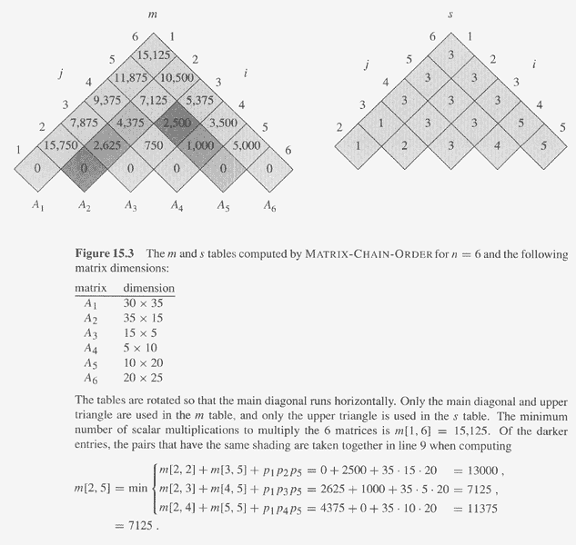
l =3
l = 2
35*15*5=2625
10*20*25=5000
m[3,4]+m[5,5] + 15*10*20 =750 + 0 + 3000 = 3750
m[3,5] = min
m[3,3]+m[4,5] + 15*5*20 =0 + 1000 + 1500 = 2500

Slide 21
Multiply matrix (example)
Consider an example with sequence of dimensions <5,2,3,4,6,7,8>
m[i, j] = min_{i ≤ k < j}{m[i, k] + m[k+1, j] + p_{i−1} p_{k} p_{j} }
1 2 3 4 5 6
1 0 30 64 132 226 348
2 0 24 72 156 268
3 0 72 198 366
4 0 168 392
5 0 336
6 0

